Slide 1
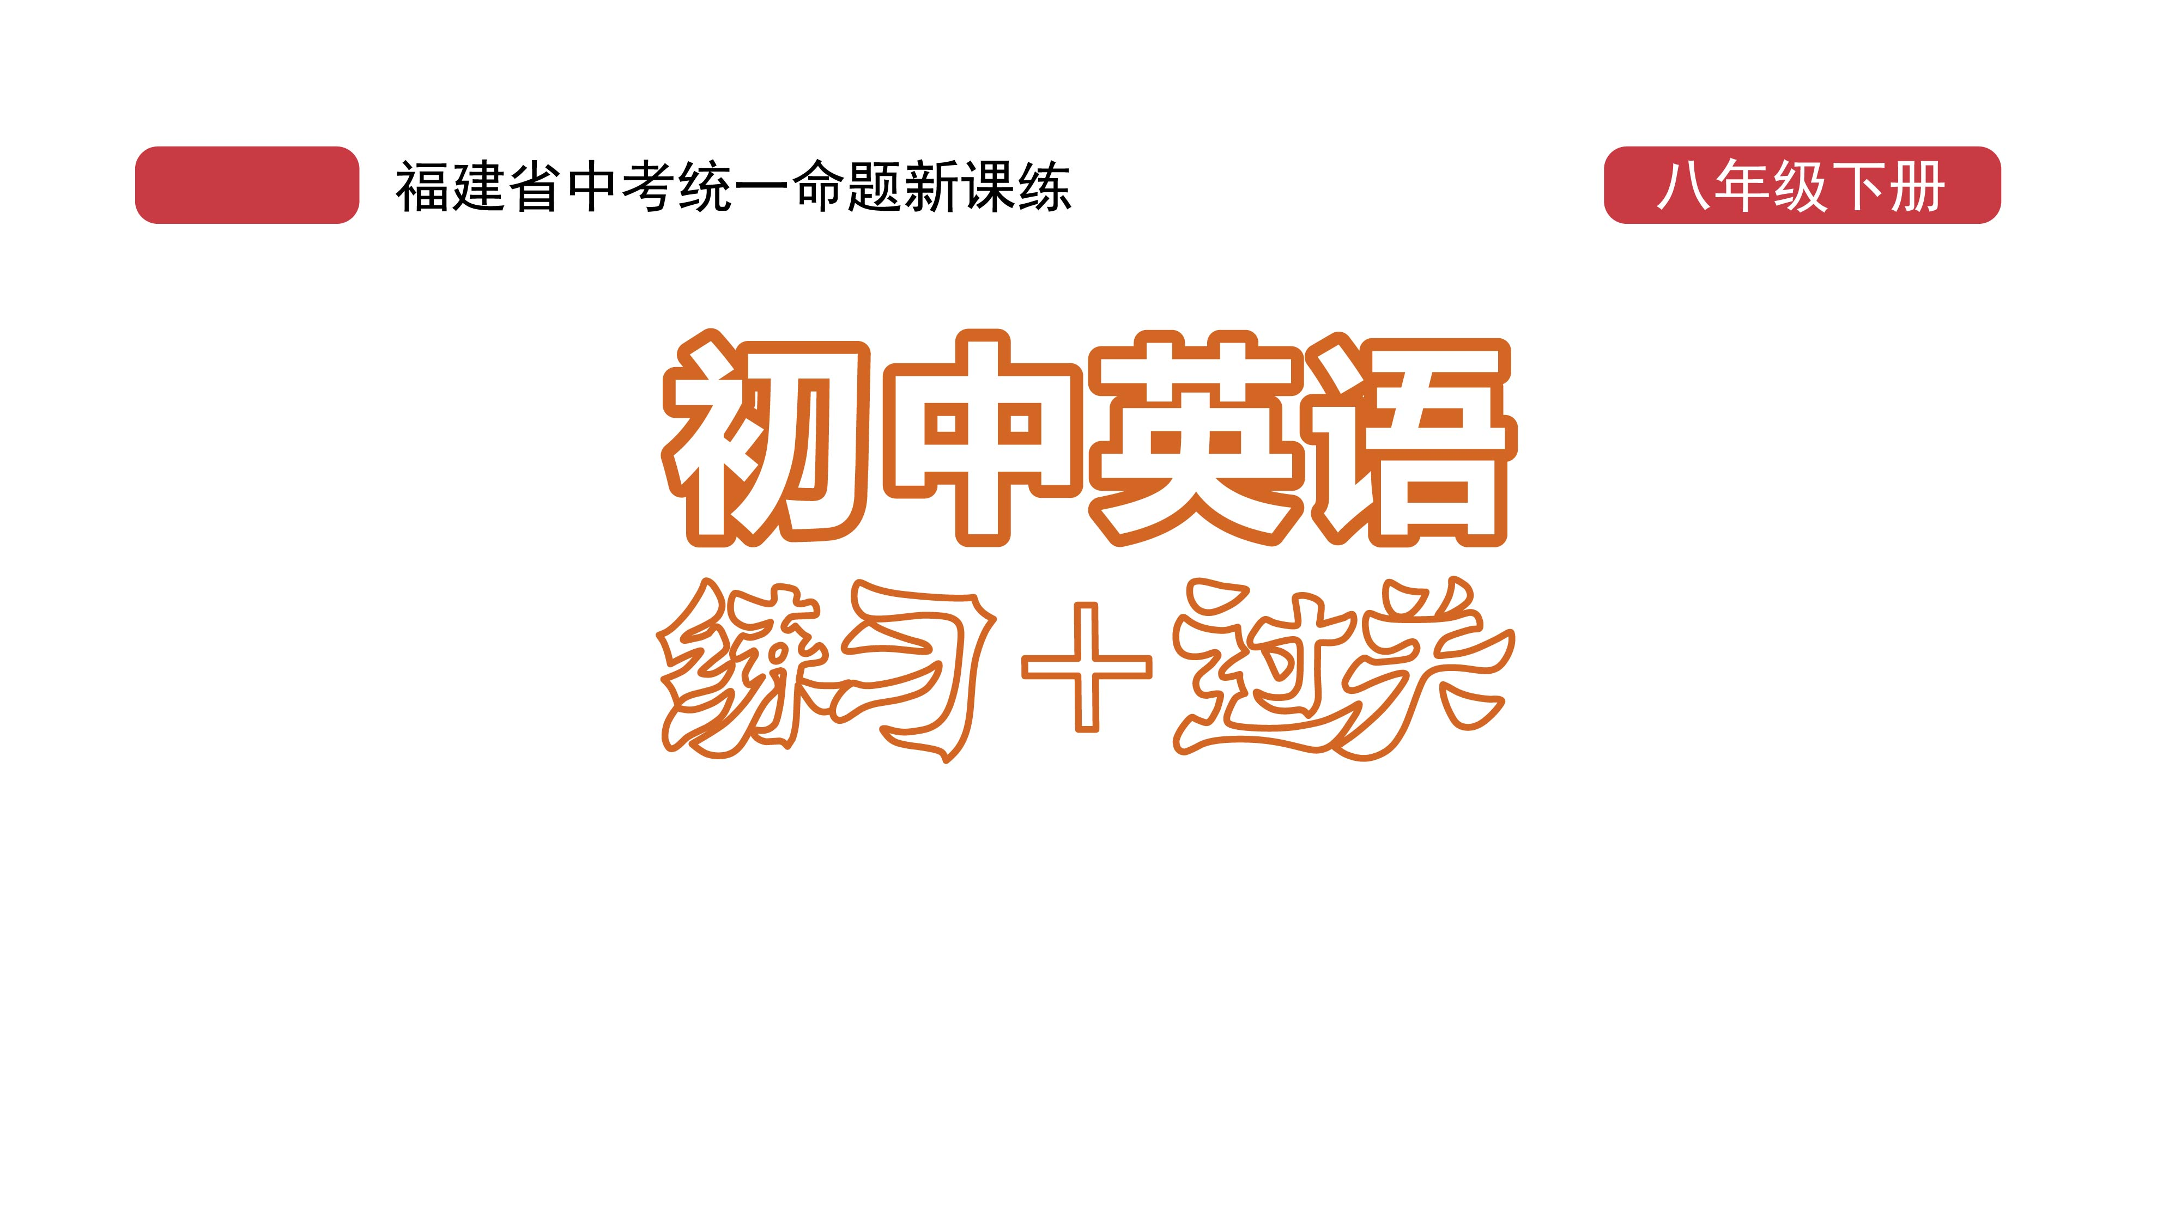
过关测试卷
模块六 第一章 测试卷

Slide 2
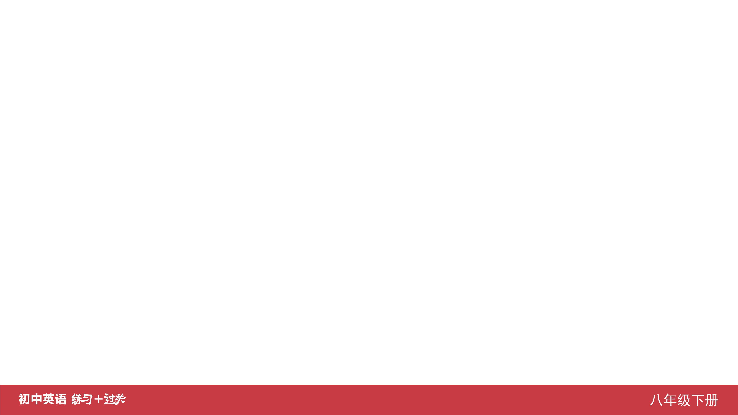
Ⅰ. 听力
1-5 ____________
6-10 ____________
11-15 ____________
16 ____________
17 ____________
18 ____________
19 ____________
20 ____________
CBABA
CBAAC
ABCAB
sunny
hotel
yellow
rode
houses

Slide 3
Ⅱ. 选择填空
21-25 ____________
26-30 ____________
31-35 ____________
CCBBA
BBCCA
BBABA

Slide 4
Ⅲ. 完形填空
36-40 ____________
41-45 ____________
BBACC
BACAC

Slide 5
Ⅳ. 阅读理解
46-50 ____________
51-55 ____________
56-60 ____________
61-65 ____________
66-70 ____________
AADBC
ABCAB
DBDAC
CCBDD
CAEBD

Slide 6
Ⅴ. 情景交际
71. ___________________________________________
72. ___________________________________________
73. ___________________________________________ 74. ___________________________________________
75. ___________________________________________
How much does it cost to get to Japan by ship?
Can you help me find out the time of the meeting?
What kinds of rooms do you have?
Did you go on a visit/trip to Hong Kong last year?
What is the price of your/the dress, Susan?

Slide 7
Ⅵ. 看图写话
76. ______________________________________________
77. ______________________________________________
78. ______________________________________________
79. ______________________________________________
80. ______________________________________________
______________________________________________
They/The family went on a spring field trip yesterday.
There are three boxes of milk in the fridge.
The boy/He paid ten yuan for the book.
The girl/She heard from her aunt last week.
The children are putting on a show to raise money./
They put on a show to raise money.

Slide 8
Ⅶ. 短文填空
Instead
an
dirty
teaching
difficulties
giving
made
when
learning
grow
81 ____________
82 ____________
83 ____________
84 ____________
85 ____________
86 ____________
87 ____________
88 ____________
89 ____________
90 ____________

Slide 9
Dear Paul,
How are you?
Do you have a May Day holiday in your country? What’s your plan? I’m looking forward to hearing from you.
Yours,
Li Ming
Ⅷ. 书面表达
I have great news to tell you. This May Day I’m going to Qingdao with my parents for a holiday. We are going there by plane. We plan to stay there for three days. When we get there, we will visit some places of interest, go swimming in the sea and enjoy the sunshine on the beach. We also plan to go shopping and taste some delicious seafood. I hope we can have a good time there.

Slide 10


